Slide 1

PROJECT

Slide 2

MOVIE DATA SET PROJECT

Slide 3

HERE I UTILIZED SQL QUERIES TO SOLVE QUESTIONS WHICH ARE RELATED TO MOVIE DATA SET

Slide 4
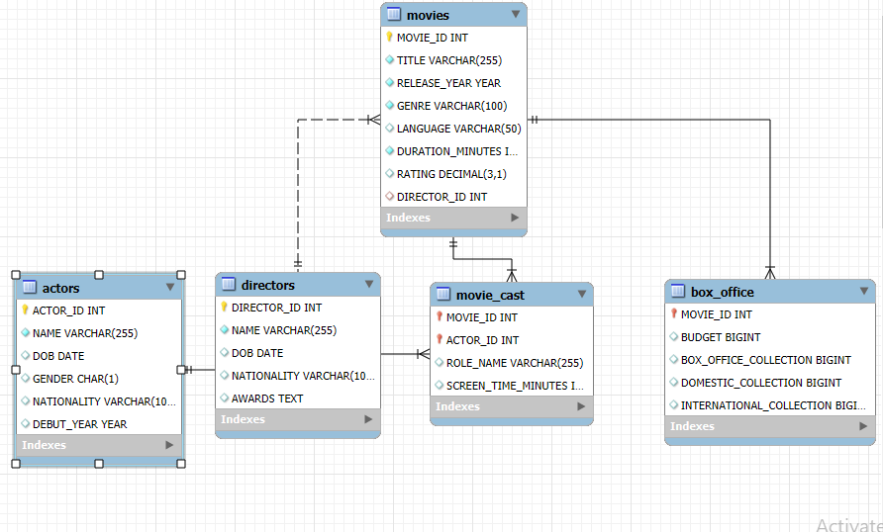
ER-DIAGRAM

Slide 5
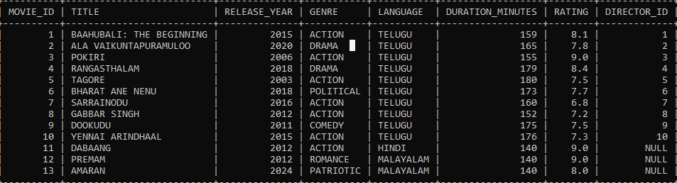
STRUCTURE OF TABLE
MOVIE TABLE:

Slide 6
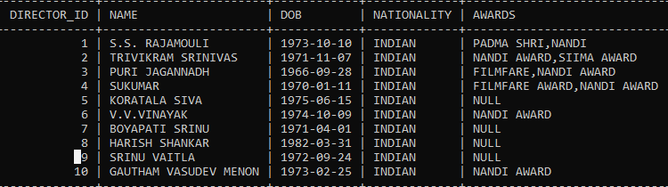
DIRECTORS TABLE

Slide 7
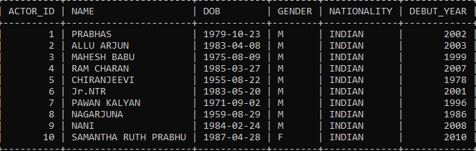
ACTORS TABLE

Slide 8
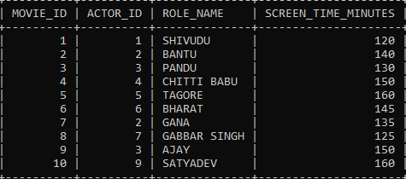
MOVIE_CAST TABLE

Slide 9
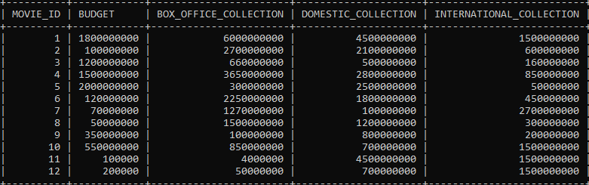
BOX_OFFICE TABLE

Slide 10

QUERIES
Q NO (1) FIND THE SUM OF BOX_OFFICE COLLECTION.
OUTPUT:
(ANS) SELECT SUM(BOX_OFFICE_COLLECTION) FROM BOX_OFFICE;

Slide 11

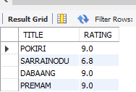
Q.NO(2): FIND THE AVERAGE RATING FOR MOVIES.
(ANS): SELECT AVG(RATING) FROM MOVIES;
OUTPUT:
Q.NO(3): FIND THE MIN AND MAX RATING FOR MOVIES.
OUTPUT:
(ANS):
SELECT
TITLE, RATING
FROM
movies
WHERE
RATING = (SELECT MIN(RATING) FROM movies)
OR RATING = (SELECT MAX(RATING) FROM movies);

Slide 12
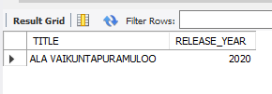
Q.NO(4):FIND THE MOVIE WHICH IS RELEASED IN 2020.
(ANS):SELECT TITLE,RELEASE_YEAR FROM MOVIES WHERE RELEASE_YEAR=2020;
OUTPUT:

Slide 13
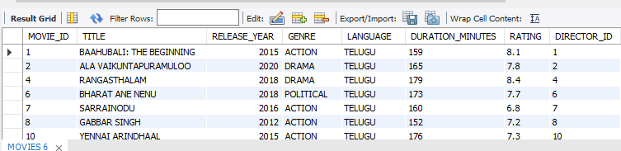
Q.NO(5): RETRIEVE THE MOVIES RELEASED AFTER THE 2011.
(ANS):SELECT * FROM MOVIES WHERE RELEASE_YEAR>2011;
OUTPUT:

Slide 14
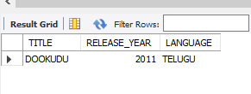
Q.NO(6): FIND TELUGU MOVIE WHICH IS RELEASED IN 2011.
(ANS):SELECT TITLE,RELEASE_YEAR,LANGUAGE FROM MOVIES WHERE LANGUAGE='TELUGU'AND RELEASE_YEAR=2011;
OUTPUT:

Slide 15
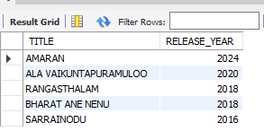
Q.NO(7): FIND THE RELEASED YEAR OF MOVIES IN DESCENDING ORDER.
(ANS): SELECT TITLE,RELEASE_YEAR FROM MOVIES ORDER BY RELEASE_YEAR DESC LIMIT 5;
OUTPUT:

Slide 16

Q.NO(8):FIND THE TOTAL COLLECTION OF MOVIES BY LANGUAGE AND SHOULD BE GREATER THAN 4000000
(ANS): SELECT LANGUAGE,SUM(BOX_OFFICE_COLLECTION) AS TOTAL_COLLECTION FROM MOVIES M JOIN BOX_OFFICE B ON M.MOVIE_ID=B.MOVIE_ID GROUP BY LANGUAGE HAVING SUM(BOX_OFFICE_COLLECTION)>4000000;
OUTPUT:

Slide 17
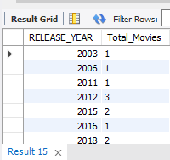
Q.NO(9): FIND THE NUMBER OF MOVIES RELEASED EACH YEAR.
(ANS):
SELECT
RELEASE_YEAR, COUNT(*) AS Total Movies
FROM
movies
GROUP BY
RELEASE_YEAR
ORDER BY
RELEASE_YEAR;
OUTPUT:

Slide 18
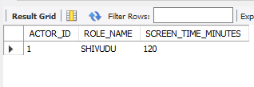
Q.NO(10): FIND ALL ACTORS AND THEIR ROLES IN SPECIFIC MOVIE.
(ANS):
SELECT
ACTOR_ID, ROLE_NAME, SCREEN_TIME_MINUTES
FROM
movie cast
WHERE
MOVIE_ID = 1;
OUTPUT

Slide 19
THANK YOU

